Slide 1
CSM51A Discussion #3
Hyunjin Kim

Slide 2
Outline
Universal Set
Characteristics of gate network
Load factor, fanout factor
CMOS Circuit
Quiz1

Slide 3
Universal Set
A set of gates is said to be universal if any combinational system can be implemented using gates just from that set.
Set {AND, OR, NOT}
Set {AND, NOT}
Set {OR, NOT}
Set {NAND}
Set {NOR}

Slide 4
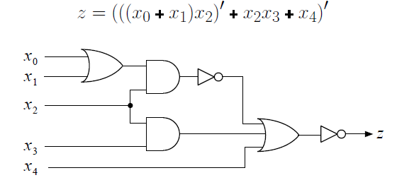
Set {AND, OR, NOT}
Any comb. System can be described by a set of switching expressions
- One to One mapping
a switching expression ↔ an AND-OR-NOT network

Slide 5
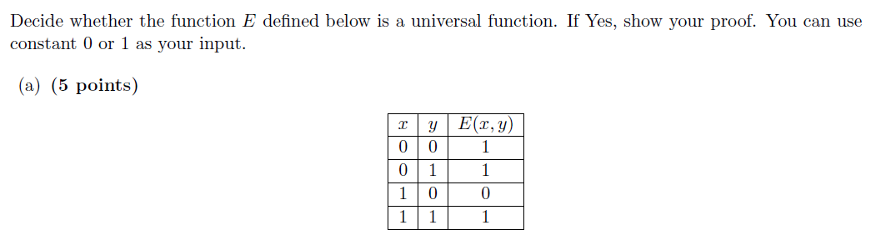
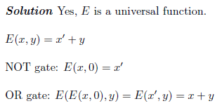
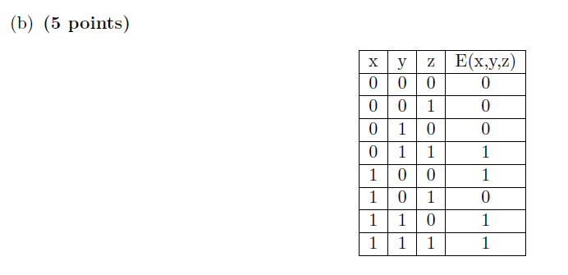
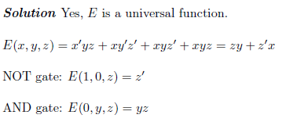

Slide 6
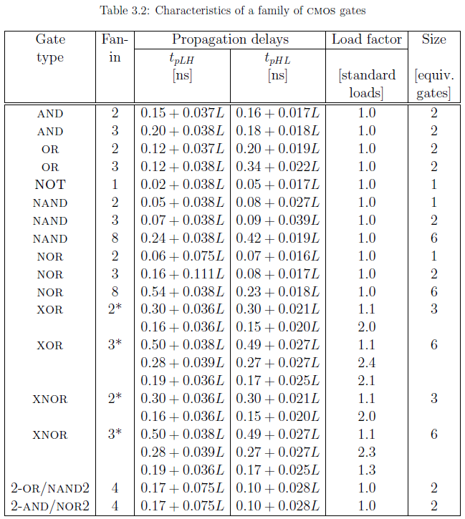

Slide 7
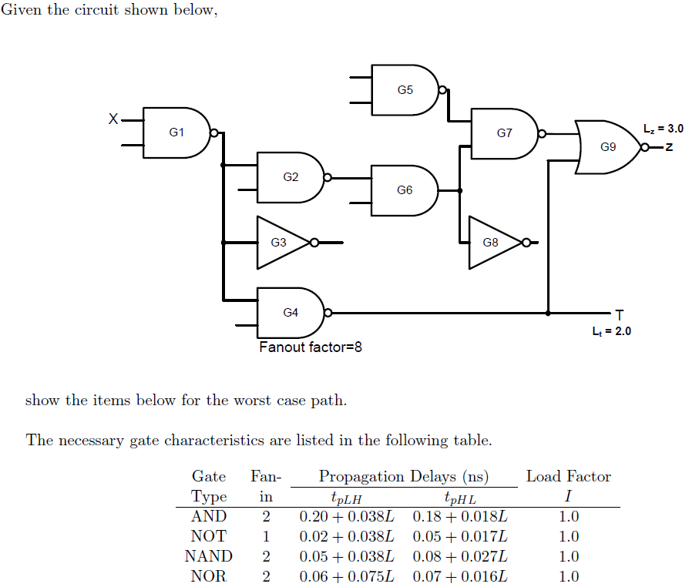
Calculate the propagation delay tpLH (x->z).

Slide 8
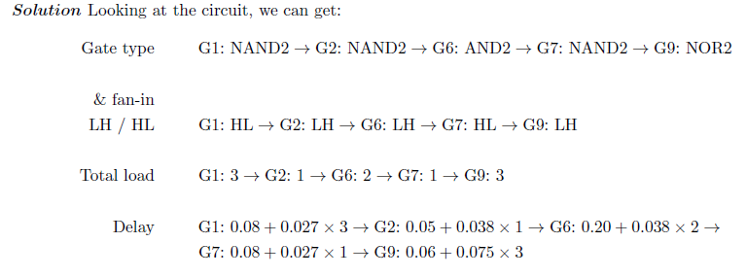
Solution
LH/HL with not, nor, nand gates
- the (LH/HL) flips with those “not” gates.
Here, G9 output is LH, but G9 is NOR gates.
Thus, G7 output (G9 input) should be HL since it will be switch to LH in G9.
Similarly, G6 output should be LH to make G7 output HL

Slide 9
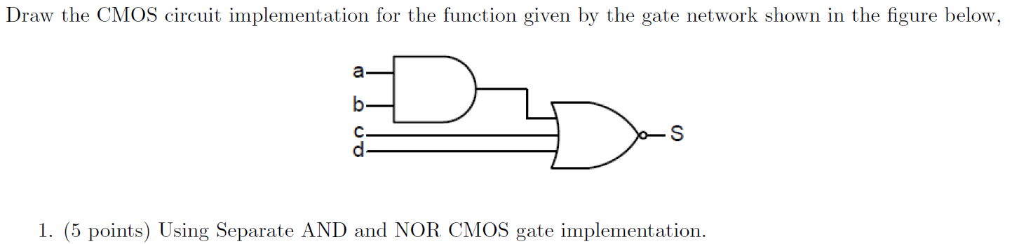
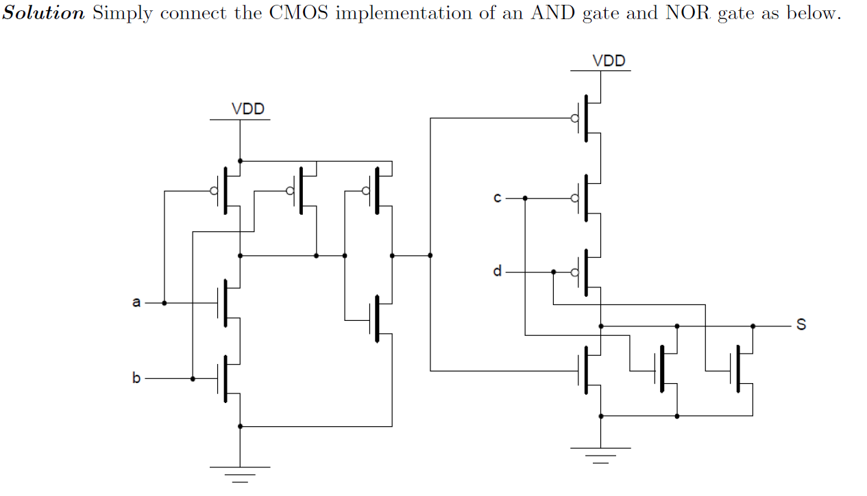

Slide 10
